Slide 1
Implicit 1D shallow water solver
By The Merge Conflict

Slide 2


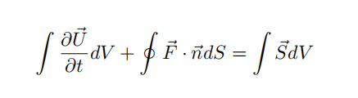
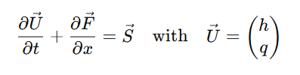
Main step:
Construct a residual function
Construct the Jacobin M=matrix
Solve the matrix problem with
Newton Iteration

Slide 3
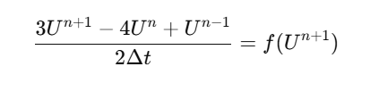
Methodology
BDF2 scheme for discretization (implicit and 2nd-order accurate)
Periodic Boundary condition, Dirichlet and Neumann

Slide 4
Result (periodic boundary)
Change of water height overtime
Change of velocity (discharge) overtime

Slide 5
Conservation of mass

Slide 6
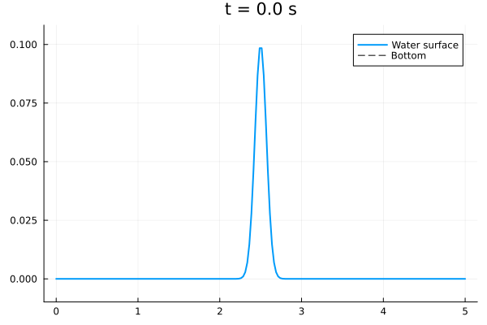
Result (Dirichlet /Neumann boundary)

Slide 7
Thanks for watching!

